Slide 1
UNIT III : STRUCTURED QUERY LANGUAGE

Slide 2
SQL: Overview
SQL (pronounced "ess-que-el") stands for Structured Query Language
Used to communicate with a database
According to ANSI (American National Standards Institute), it is the standard language for relational database management systems
Common relational database management systems that use SQL are: Oracle, Sybase, Microsoft SQL Server, Access, Ingres, etc.

Slide 3
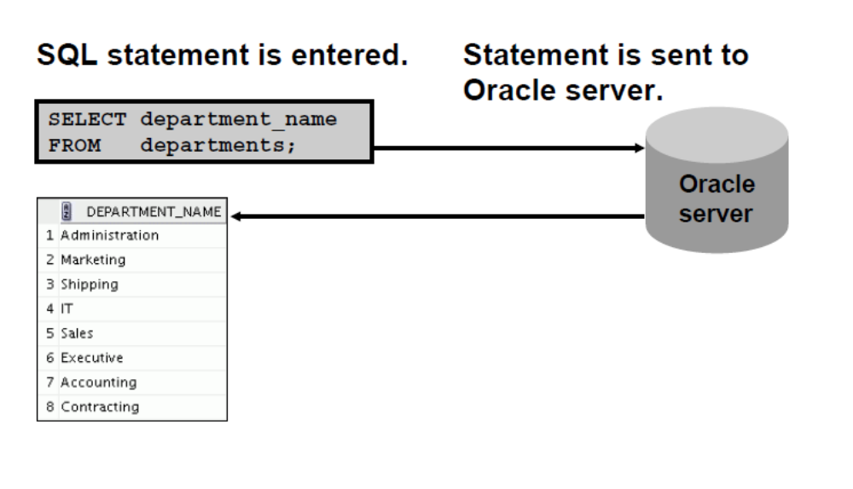
Communicating with an RDBMS
Using SQL

Slide 4
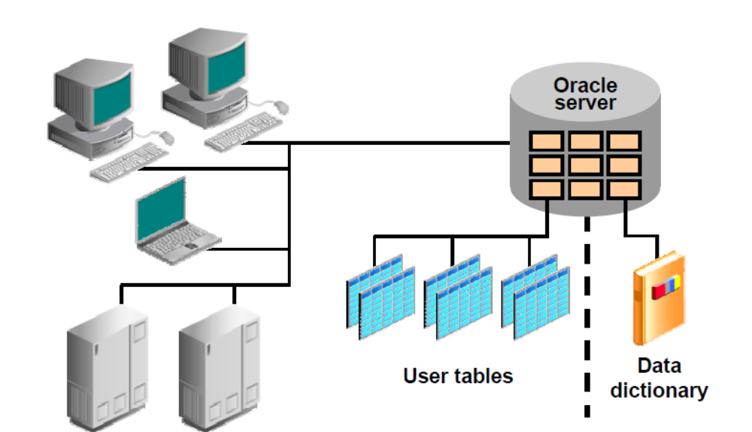
Oracle’s Relational Database Management
System

Slide 5
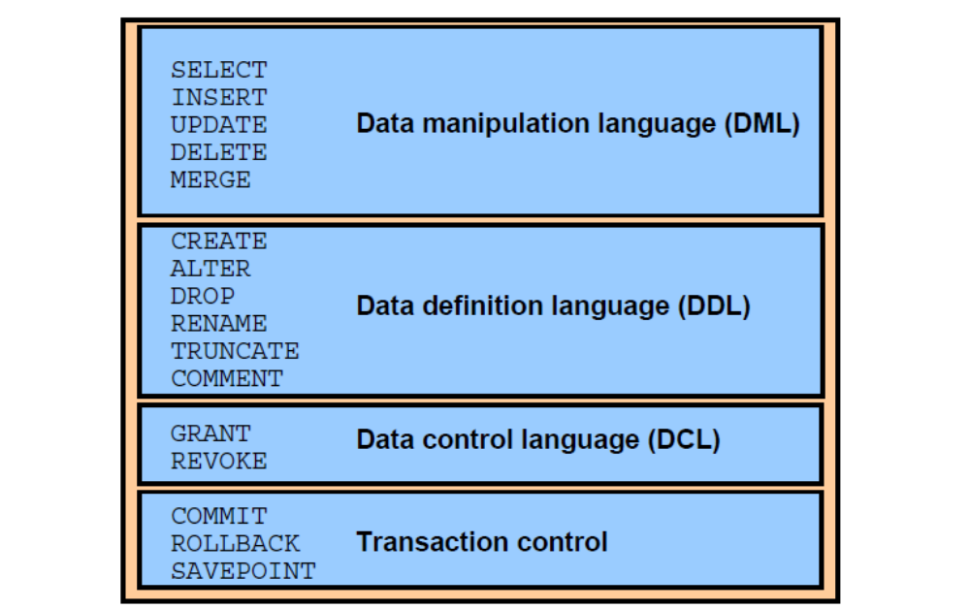
SQL Statements

Slide 6
The Form of Basic SQL Query

Slide 7
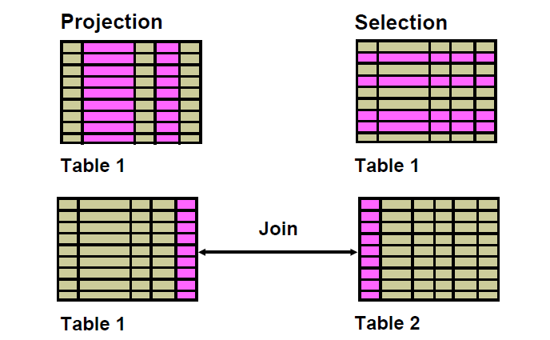
Capabilities of SQL SELECT Statements

Slide 8
Basic SELECT Statement
Select *|{[DISTINCT] column|expression [alias],... From table;
SELECT identifies the columns to be displayed.
FROM identifies the table containing those columns

Slide 9
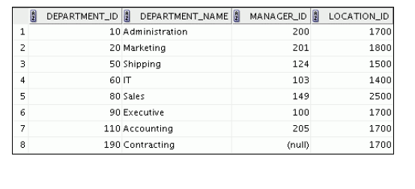
Selecting All Columns select * from departments;

Slide 10
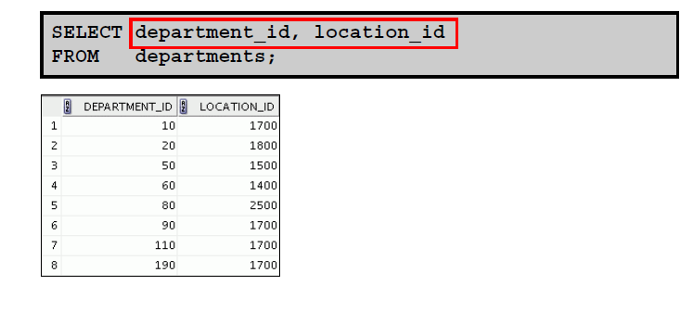
Selecting Specific Columns

Slide 11
Writing SQL Statements
SQL statements are not case-sensitive.
SQL statements can be on one or more lines.
Keywords cannot be abbreviated or split
across lines.
Clauses are usually placed on separate lines.
Indents are used to enhance readability.
In SQL Developer, SQL statements can optionally be terminated by a semicolon (;). Semicolons are required if you execute multiple SQL statements.
In SQL*Plus, you are required to end each SQL statement
with a semicolon (;).

Slide 12
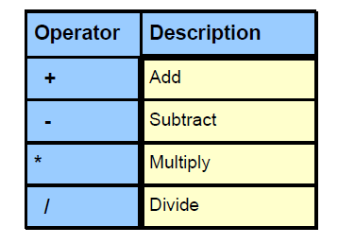
Arithmetic Expressions
Create expressions with number and date data by using arithmetic operators.

Slide 13
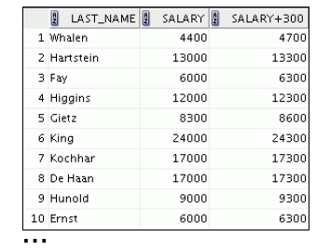
Using Arithmetic Operators
SELECT last_name, salary, salary + 300
FROM employees;

Slide 14


Operator Precedence
SELECT last_name, salary, 12*salary+100
FROM employees;
SELECT last_name, salary, 12*(salary+100)
FROM employees;

Slide 15
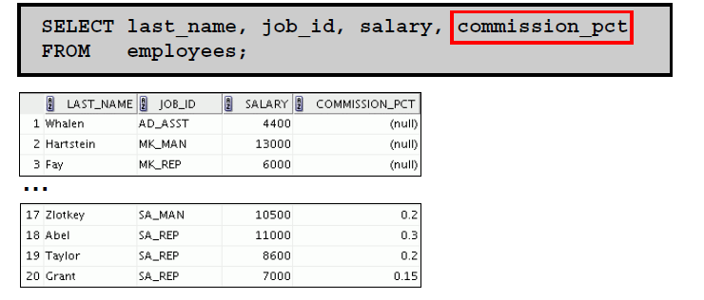
Defining a Null Value
A null is a value that is unavailable, unassigned, unknown,or inapplicable.
A null is not the same as a zero or a blank space.

Slide 16
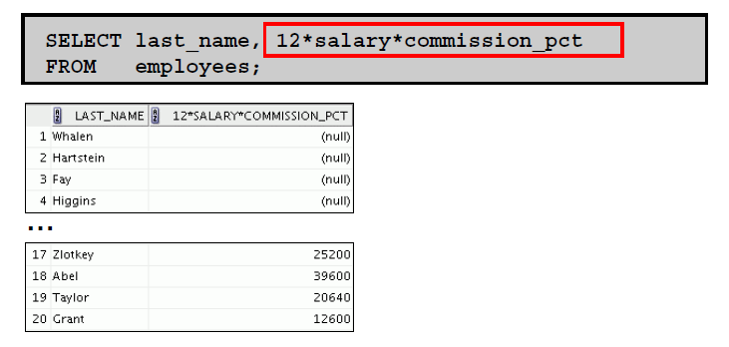
Null Values in Arithmetic Expressions

Slide 17
Defining a Column Alias
A column alias:
Renames a column heading
Is useful with calculations
Immediately follows the column name (There can also be the optional AS keyword between the column name and alias.)
Requires double quotation marks if it contains spaces or special characters, or if it is case-sensitive

Slide 18
Using Column Aliases
SELECT last_name AS name, Commission_pct comm
FROM employees;
SELECT last_name "Name" , salary*12 "Annual Salary” FROM employees;

Slide 19
Concatenation Operator
A concatenation operator:
Links columns or character strings to other columns
Is represented by two vertical bars (||)
Creates a resultant column that is a character expression
SELECT last_name||job_id AS "Employees“ FROM employees;

Slide 20
Literal Character Strings
A literal is a character, a number, or a date that is included in the SELECT statement.
Date and character literal values must be enclosed by single quotation marks.
Each character string is output once for each
row returned.

Slide 21
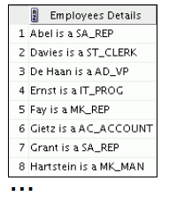
Using Literal Character Strings
SELECT last_name ||' is a '||job_id
AS "Employee Details“ FROM employees;

Slide 22
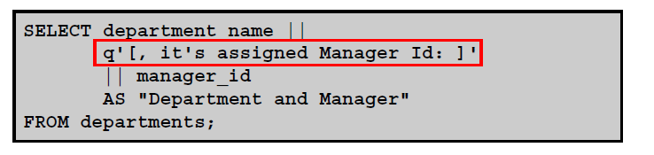
Alternative Quote (q) Operator
Specify your own quotation mark delimiter.
Choose any delimiter.
Increase readability and usability.

Slide 23
Duplicate Rows
The default display of queries is all rows, including duplicate rows.
Select department_id from employee;
Select DISTINCT department_id from employee;

Slide 24
UNION, INTERSECT, and EXCEPT

Slide 25
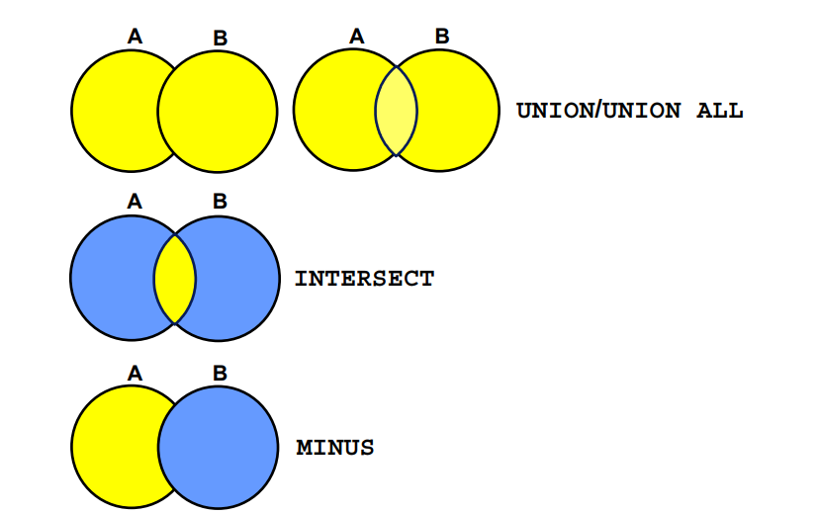
Set Operators

Slide 26
Definitions
Union
  The UNION operator returns results from both queries after eliminating duplications.
Intersection
  The INTERSECT operator returns rows that are common to both queries.
Minus
  The MINUS operator returns rows in the first query that are not present in the second query.

Slide 27
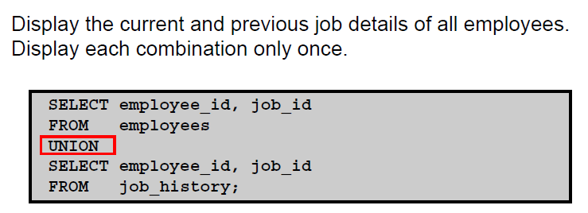
Using the Union Operator

Slide 28
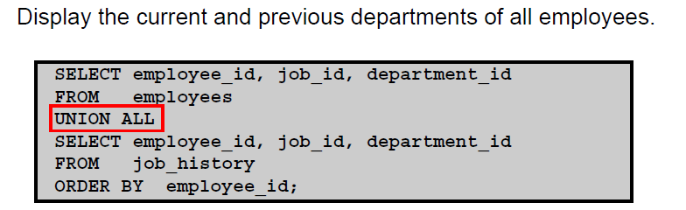
Using the Union All Operator

Slide 29
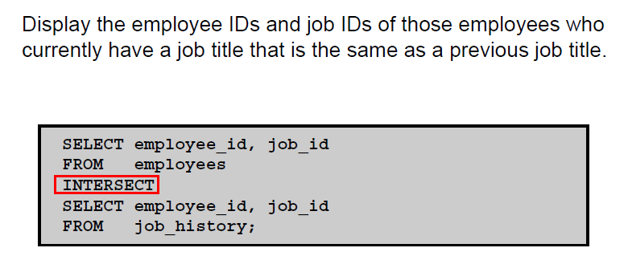
Using the Intersect Operator

Slide 30
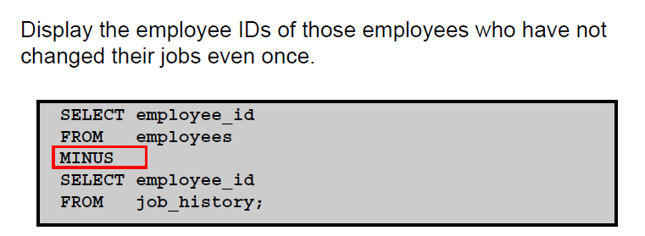
Using the Minus Operator

Slide 31
Set Operator Guidelines
The expressions in the SELECT lists must match in number and data type.
Parentheses can be used to alter the sequence of execution.
The ORDER BY clause:
  Can appear only at the very end of the statement
  Will accept the column name, aliases from the first SELECT statement, or the positional notation

Slide 32
Oracle Server and Set Operators
Duplicate rows are automatically eliminated except in UNION ALL.
Column names from the first query appear in the result.
The output is sorted in ascending order by default except in UNION ALL.

Slide 33
Nested Queries

Slide 34
Definition
A Subquery or Inner query or a Nested query is a query within another SQL query and embedded within the WHERE clause. A subquery is used to return data that will be used in the main query as a condition to further restrict the data to be retrieved.

Slide 35
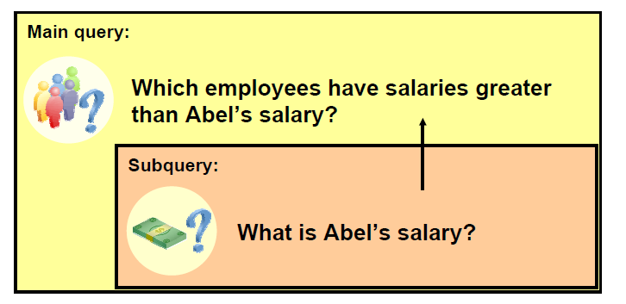
Using a Subquery to Solve a Problem
Who has a salary greater than Abel?

Slide 36
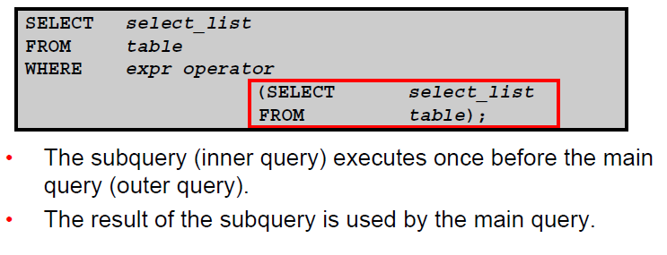
Syntax

Slide 37
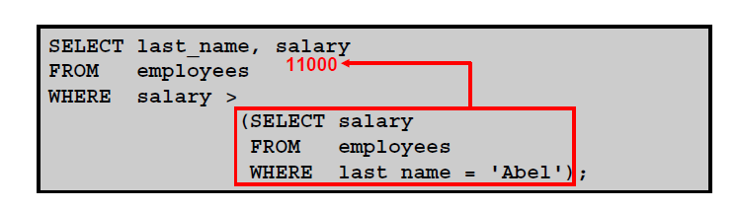
Using a Sub Query

Slide 38
Guidelines for Using a Sub query
Enclose subqueries in parentheses.
Place subqueries on the right side of the comparison condition.
The ORDER BY clause in the subquery is not needed unless you are performing Top-N analysis.
Use single-row operators with single-row subqueries, and use multiple-row operators with multiple-row subqueries.

Slide 39
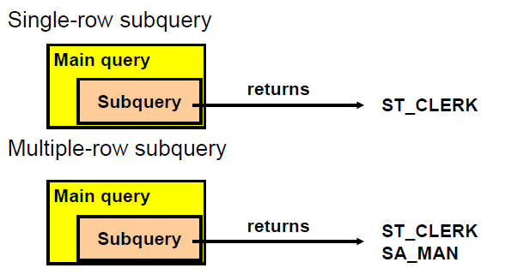
Types of Subqueries

Slide 40
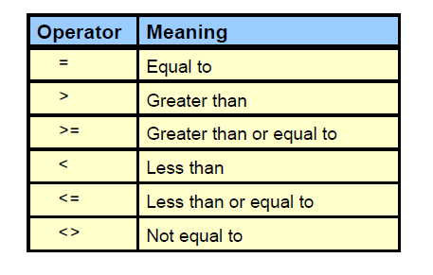
Single-Row Subqueries
Return only one row
Use single-row comparison operators

Slide 41
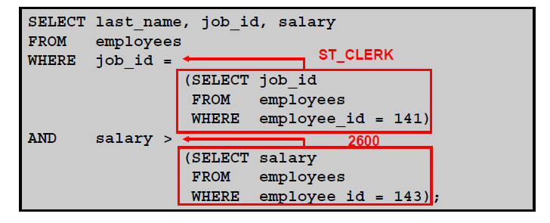
Executing Single-Row Subqueries

Slide 42
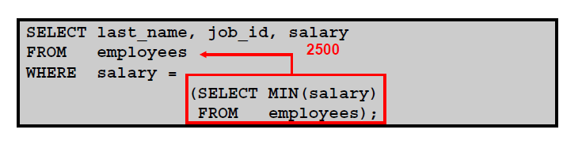
Using Group Functions in a Subquery

Slide 43
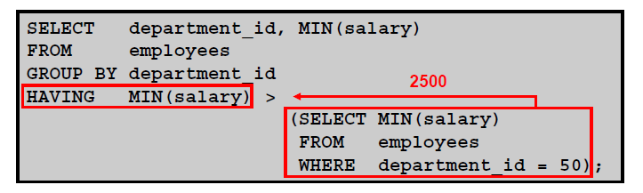
The HAVING Clause with Subqueries

Slide 44
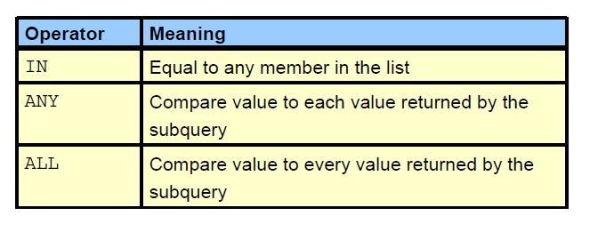
Multiple-Row Subqueries
Return more than one row
Use multiple-row comparison operators

Slide 45
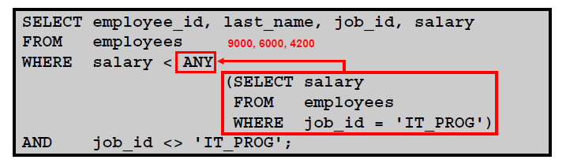
Using the ANY Operator in Multiple-Row Subqueries

Slide 46
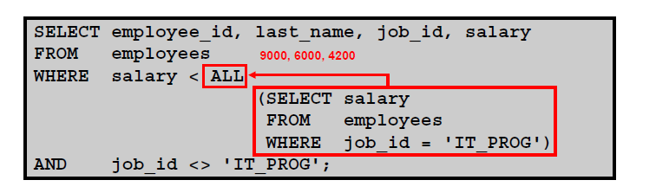
Using the ALL Operator in Multiple-Row Subqueries

Slide 47
Aggregate Functions

Slide 48
Aggregate Functions
Aggregate or Group functions operate on sets of rows to give one result per group
  Ex.
    Sum of the salary
    Batting Average
    Number of Students in a class

Slide 49
Group Functions
AVG
COUNT
MAX
MIN
SUM

Slide 50
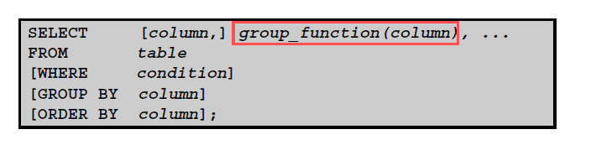
Syntax

Slide 51
Examples
Select Avg(salary) From Emp;
Select Count(Student_name) From Student;
Select Max(Marks_Maths) from Class_marks;
Select Min(Marks_Maths) from Class_marks;
Select Sum(Score) from Cric_Scores;

Slide 52

Using the DISTINCT Keyword
COUNT(DISTINCT expr) returns the number of distinct non-null values of expr.
To display the number of distinct department values in the EMPLOYEES table:

Slide 53
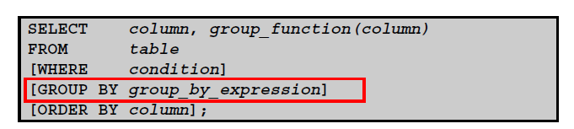
Creating Groups of Data:
GROUP BY Clause Syntax
Divide rows in a table into smaller groups by using the GROUP BY clause

Slide 54
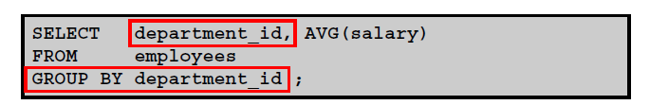
Using the GROUP BY Clause
All columns in the SELECT list that are not in group functions must be in the GROUP BY clause.

Slide 55
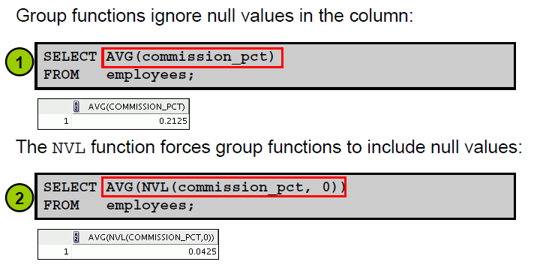
Group Functions and Null Values

Slide 56
Complex Integrity Constraints

Slide 57
Constraints
Constraints enforce rules at the table level.
Constraints prevent the deletion of a table if there are dependencies.
The following constraint types are valid
  NOT NULL
  UNIQUE
  PRIMARY KEY
  FOREIGN KEY
  CHECK

Slide 58
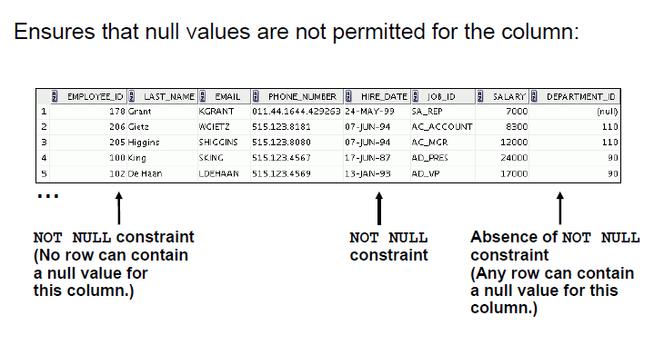
NOT NULL Constraint

Slide 59
Syntax
Create table Student(Roll_No Number, Sname Varchar(20) Not null,…);
Create table Employee(Eid Number Unique,…);
Create table Academics(Student_id Number Primary Key,..);
Create Table Faculty_Advisor(Faculty_Name Varchar(20), Student_id references Academics(Student_id),…);
Create Table Factory(Factory_name varchar(20), Total_Products number, check total_Products<50000);

Slide 60
Embedded SQL

Slide 61
Embedded SQL
Embedded SQL is a method of combining the computing power of a programming language and the database manipulation capabilities of SQL.
Embedded SQL statements are SQL statements written inline with the program source code of the host language

Slide 62
Embedded SQL
The SQL standard defines embeddings of SQL in a variety of programming languages such as C, Java, and Cobol.
A language to which SQL queries are embedded is referred to as a host language, and the SQL structures permitted in the host language comprise embedded SQL.
The basic form of these languages follows that of the System R embedding of SQL into PL/I.
EXEC SQL statement is used to identify embedded SQL request to the preprocessor
EXEC SQL <embedded SQL statement > END_EXEC
Note: this varies by language (for example, the Java embedding uses
# SQL { …. }; )

Slide 63
Example Query
From within a host language, find the names and cities of customers with more than the variable amount dollars in some account.
Specify the query in SQL and declare a cursor for it
EXEC SQL
declare c cursor for
select depositor.customer_name, customer_city
from depositor, customer, account
where depositor.customer_name = customer.customer_name
and depositor account_number = account.account_number
and account.balance > :amount
END_EXEC

Slide 64
Embedded SQL (Cont.)
The open statement causes the query to be evaluated
EXEC SQL open c END_EXEC
The fetch statement causes the values of one tuple in the query result to be placed on host language variables.
EXEC SQL fetch c into :cn, :cc END_EXEC
Repeated calls to fetch get successive tuples in the query result
A variable called SQLSTATE in the SQL communication area (SQLCA) gets set to ‘02000’ to indicate no more data is available
The close statement causes the database system to delete the temporary relation that holds the result of the query.
EXEC SQL close c END_EXEC
Note: above details vary with language. For example, the Java embedding defines Java iterators to step through result tuples.

Slide 65
Object Oriented database

Slide 66
Definition of an object
Objects – User defined complex data types
An object has structure or state (variables) and methods (behavior/operations)
An object is described by four characteristics
Identifier: a system-wide unique id for an object
Name: an object may also have a unique name in DB (optional)
Lifetime: determines if the object is persistent or transient
Structure: Construction of objects using type constructors

Slide 67
Object Structure
The state (current value) of a complex object may be constructed from other objects (or other values) by using certain type constructors
Can be represented by (i,c,v)
  i is an unique id
  c is a type constructor
  v is the object state
Constructors
  Basic types: atom, tuple and set
  Collection type: list, bag and array

Slide 68
Definition of an object
Objects – User defined complex data types
An object has structure or state (variables) and methods (behavior/operations)
An object is described by four characteristics
Identifier: a system-wide unique id for an object
Name: an object may also have a unique name in DB (optional)
Lifetime: determines if the object is persistent or transient
Structure: Construction of objects using type constructors

Slide 69
Object Structure
The state (current value) of a complex object may be constructed from other objects (or other values) by using certain type constructors
Can be represented by (i,c,v)
  i is an unique id
  c is a type constructor
  v is the object state
Constructors
  Basic types: atom, tuple and set
  Collection type: list, bag and array

Slide 70
Object-Oriented Concepts
Abstract Data Types
  Class definition, provides extension to complex attribute types
Encapsulation
  Implementation of operations and object structure hidden
Inheritance
  Sharing of data within hierarchy scope, supports code reusability
Polymorphism
  Operator overloading

Slide 71
What is Object Oriented Database? (OODB)
A database system that incorporates all the important object-oriented concepts
Some additional features
  Unique Object identifiers
  Persistent object handling

Slide 72
Advantages of OODBS
Designer can specify the structure of objects and their behavior (methods)
Better interaction with object-oriented languages such as Java and C++
Definition of complex and user-defined types
Encapsulation of operations and user-defined methods

Slide 73
User defined Data Types
Creating a “row type”
  Example:
  create row type AddressType(
  street char(50),
  city char(20));
  create row type StarType(
  name char(30),
  address AddressType);

Slide 74
Creating Data Types (contd.)
Creating “Table”
create table Address of type AddressType;
create table MovieStar of type StarType;
Instances of Row types are tuples in tables

